Slide 1
Database integration in Flutter Google Firebase
Mărgineanu Adrian, Crăciun Octavian & Ioniță Dragoș

Slide 2

First off… What is a Database?

Slide 3

A database is an organized collection of data, generally stored and accessed electronically from a computer system.

Slide 4

What can be done with a database?

Slide 5
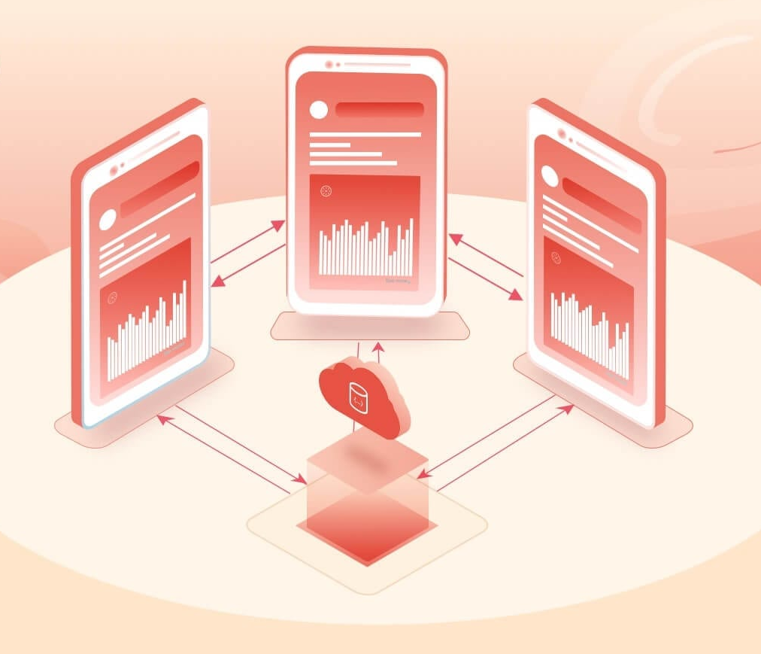
Existing DBMSs provide various functions that allow management of a database and its data which can be classified into four main functional groups:
Data definition
Update
Retrieval
Administration

Slide 6

Databases for mobile development need to be
Lightweight as storage is limited on mobile devices.
No server requirement.
In the form of the library with no or minimal dependency (embeddable) so that it can be used when needed
Fast and secure.
Easy to handle through code, and the option to make it private or shared with other
applications.
Low memory and power consumption.

Slide 7



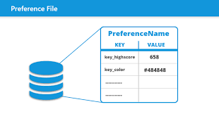

Some popular databases for Flutter
SQLite
MongoDB
Hive
Google Firebase
SharedPreferences

Slide 8

What is Google Firebase?

Slide 9
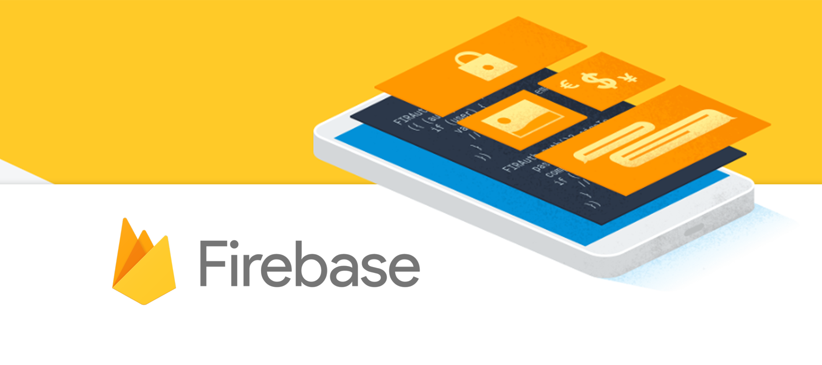
Firebase is a platform developed by Google for creating mobile and web applications. Google acquired the platform and it is now their flagship offering for app development.

Slide 10

Firebase offers two cloud-based, client-accessible database solutions that support realtime data syncing:
RealTime Database and Cloud Firestore

Slide 11
RealTime Database
Realtime Database is Firebase's original database. It's an efficient, low-latency solution for mobile apps that require synced states across clients in realtime.
Stores data as one large JSON tree.
Simple data is very easy to store.
Complex, hierarchical data is harder to organize at scale.
Presence supported.
Deep queries with limited sorting and filtering functionality.
Basic write and transaction operations.
Realtime Database is a regional solution.
Scaling requires sharding.
Cascading rules language that separates authorization and validation.

Slide 12
Cloud Firestore
Cloud Firestore is Firebase's newest database for mobile app development. It builds on the successes of the Realtime Database with a new, more intuitive data model. Cloud Firestore also features richer, faster queries and scales further than the Realtime Database.
Stores data as collections of documents.
Simple data is easy to store in documents, which are very similar to JSON.
Complex, hierarchical data is easier to organize at scale, using subcollections within
documents.
Presence is NOT supported natively.
Indexed queries with compound sorting and filtering.
Advanced write and transaction operations.
Cloud Firestore is a regional and multi-region solution that scales automatically.
Scaling is automatic.
Non-cascading rules that combine authorization and validation.

Slide 13
Other useful Firebase features
Authentication
Storage
Hosting
Functions
Analytics
Machine Learning
Cloud Messaging
In-App Messaging
Ad Mob

Slide 14
Useful resources
https://firebase.googleblog.com/2017/10/cloud-firestore-for-rtdb-developers.html/ - Useful comparison between the two DBs
https://medium.com/datadriveninvestor/realtime-database-vs-cloud-firestore-which-database-is-suitable-for-your-mobile-app-87e11b56f50f - Another extensive comparison
https://firebase.google.com/docs - Official Google Firebase Documentation
https://console.firebase.google.com/ - Console for Firebase

Slide 15

Enough talking, let’s get coding!

